Slide 1
‘Mobility as a service’ in practice and urban development
Jointly contributing to low-car, and low-carbon and affordable
housing: the Bremen Hulsberg case (H2020 project SUNRISE)
Michael Glotz-Richter, City of Bremen, Germany

Slide 2
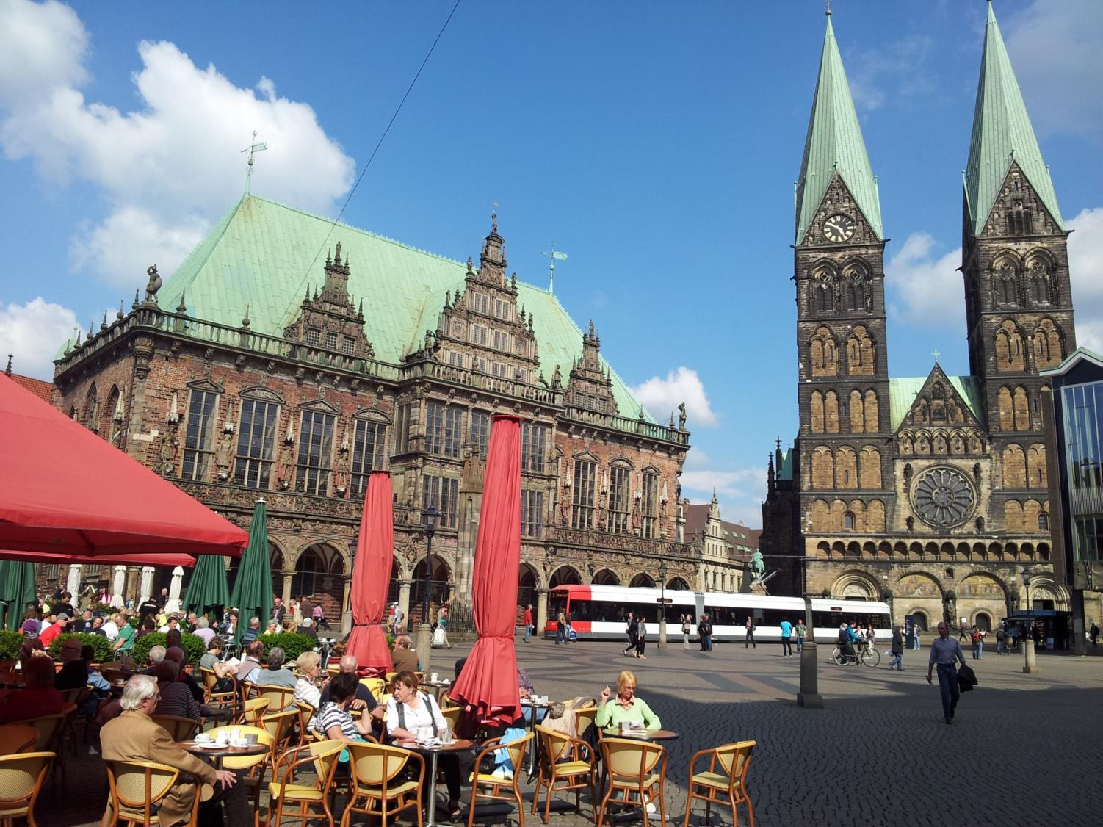
Welcome to Bremen
558.000 inhabitants

Slide 3
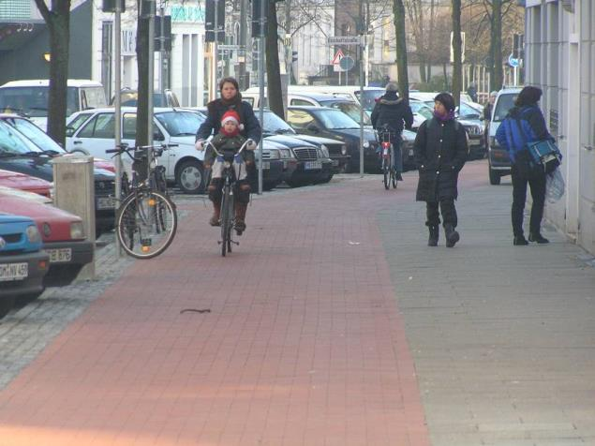
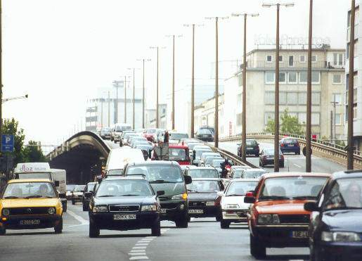
Modal Split Bremen
Modal split
All trips (Bremen citizens)
walking
25
Bicycle
23 (+)
36 (-)
16 (+)
car
PT
source: SrV 2013

Slide 4
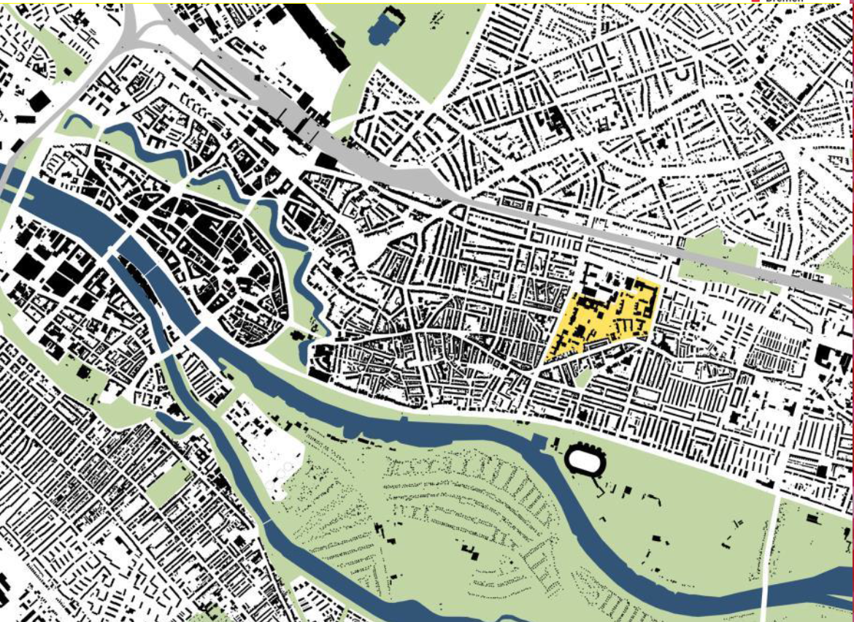
1. New Development Area (conversion hospital)

Slide 5
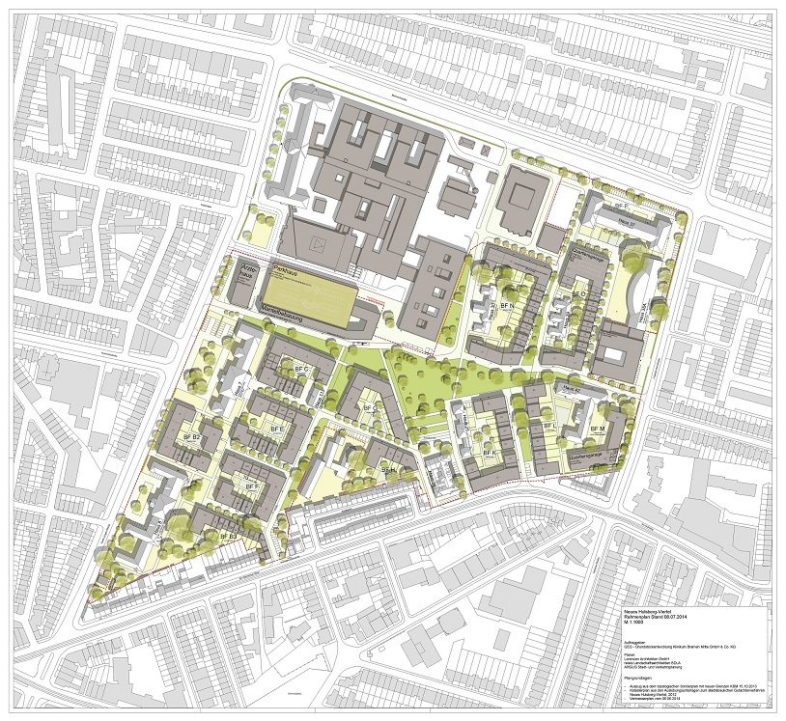
1. New Development Area (conversion hospital)
hospital
10 hectars new development
~ 1,100 housing units
~ 2.400 inhabitants

Slide 6
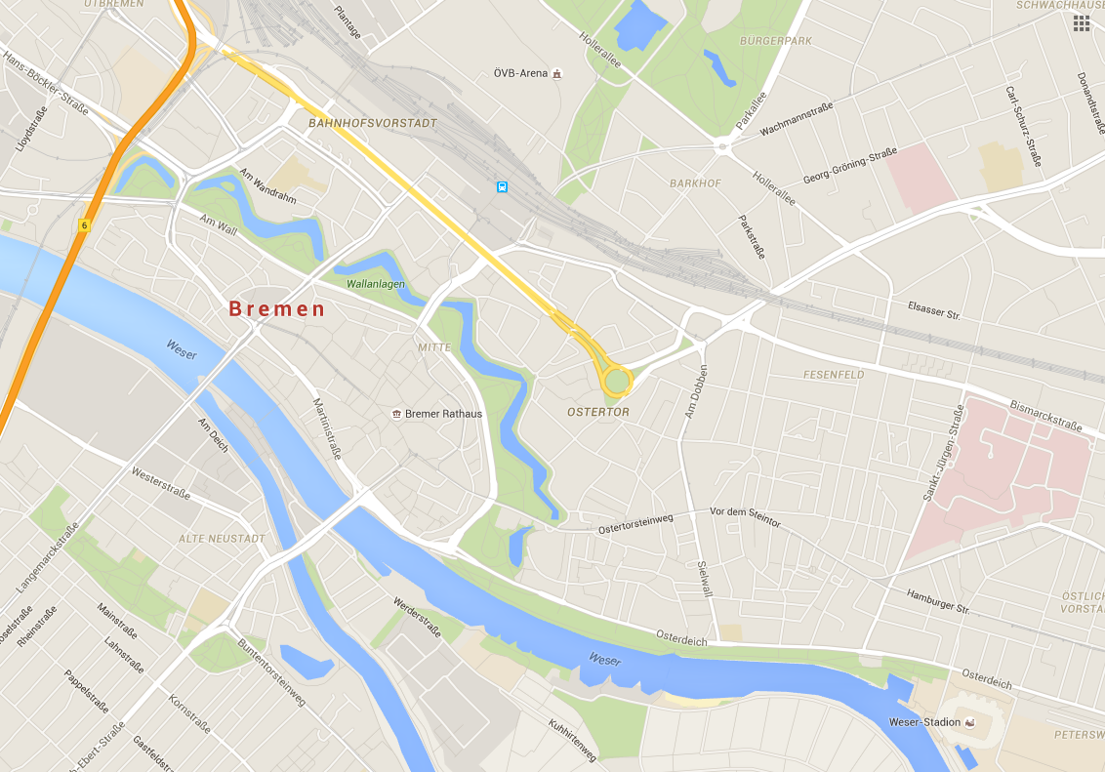
Accessibility
bicycle
Historic centre
Hulsberg

Slide 7
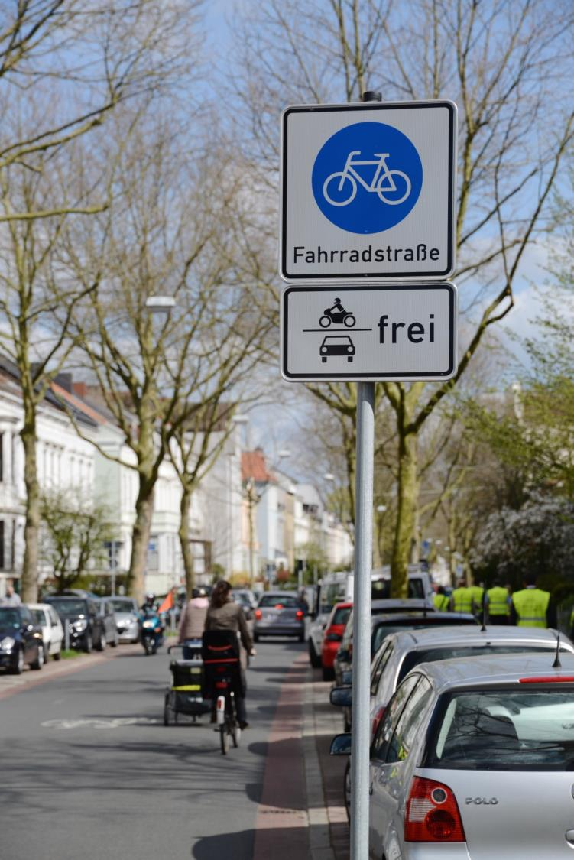
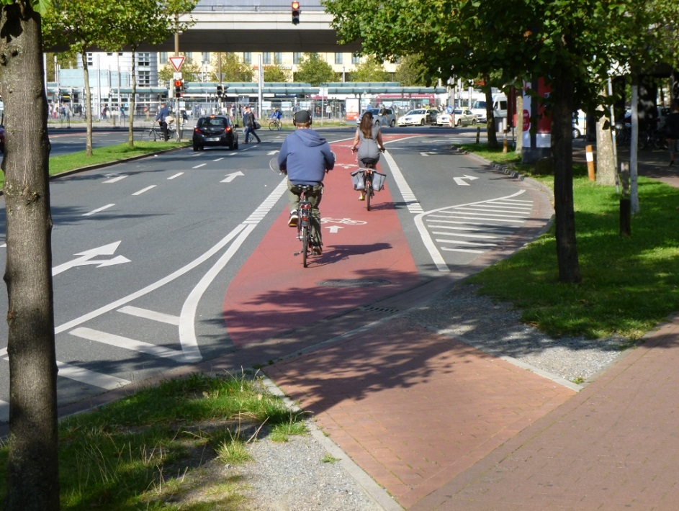
Accessibility
bicycle

Slide 8
Accessibility
Public transport
Hulsberg
Historic centre
Borough shopping area

Slide 9
Modal split of new residents
Non-motorised
50 + %
car
15 – 20 %
25 %
9
PT
Car ownership: < 40% of households

Slide 10
Affordable housing
Consider costs for mobility:
Costs for car-parking
Costs of car ownership
30,000 € -
50,000 €
10 – 15 % of construction costs

Slide 11
2. Neighbourhood around New Development Area
H

Slide 12
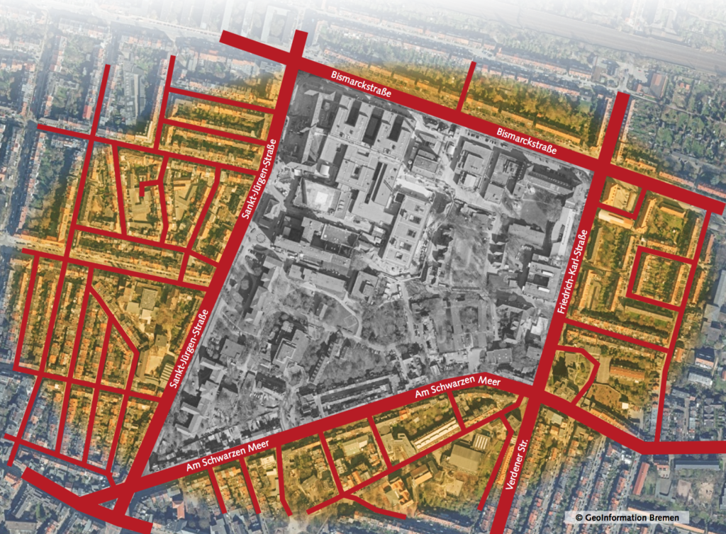
2. Neighbourhood around New Development Area

Slide 13
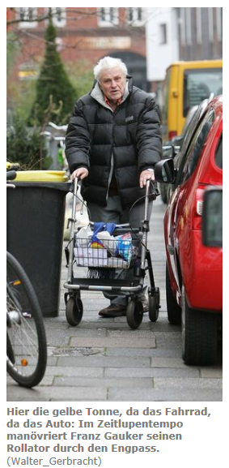
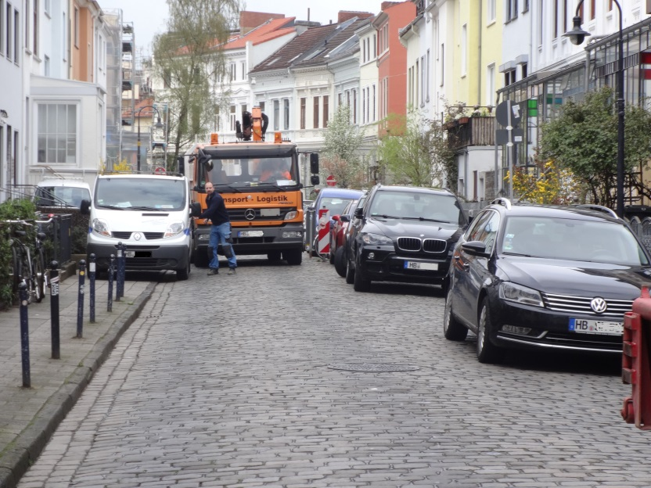
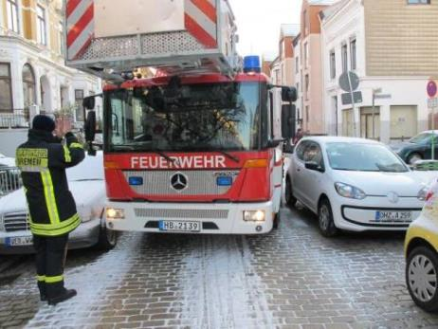
WeserKurier

Slide 14
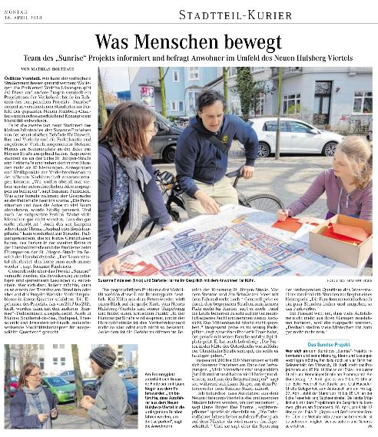
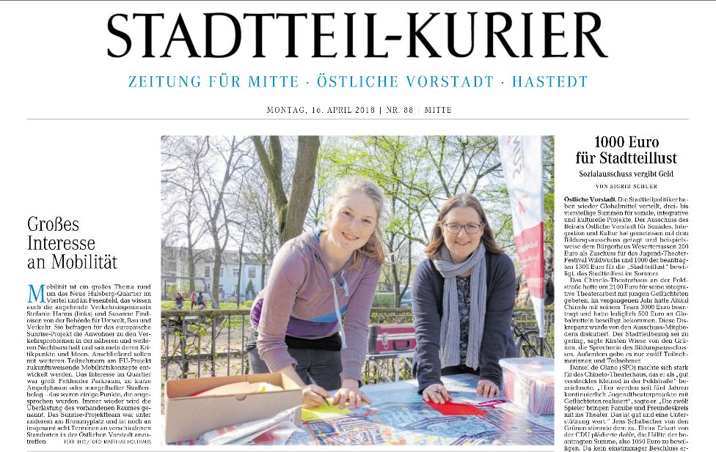
On-street participation

Slide 15
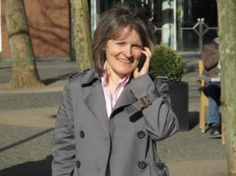
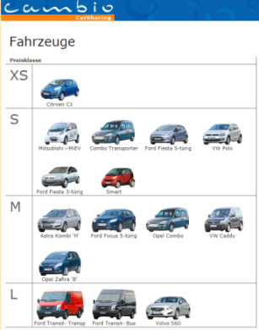
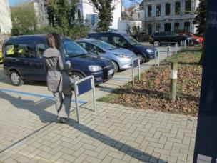
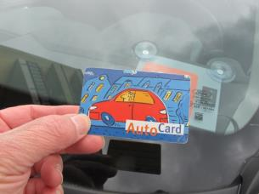
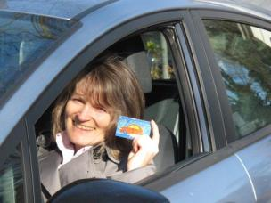
Car-Sharing in Bremen
Reservation (in advance or spontaneous) via Internet, phone or smartphone app
Station
Access
drive… (and return)

Slide 16
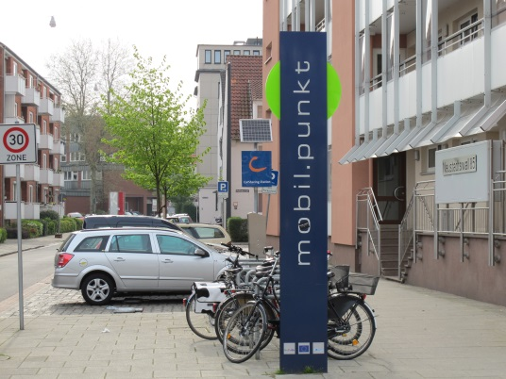
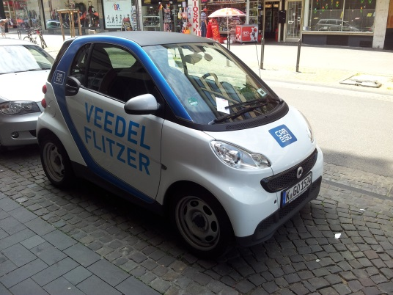
Car-Sharing
Station-based (return) Car-Sharing:
reservation spontanous or long-time ahead
variety of cars
Average trip ∼ 40 – 50 km
Free-floating Car-Sharing :
Only spontaneous use (max reservation 30 min)
Leaving the car only in ‚operational area‘
Average trip ∼ 6 – 10 km (urban trips)
Free-floating Car-Sharing (not in Bremen):
Only spontaneous use (max reservation 30 min)
Leaving the car only in ‚operational area‘
Average trip ∼ 6 – 10 km (urban trips)

Slide 17
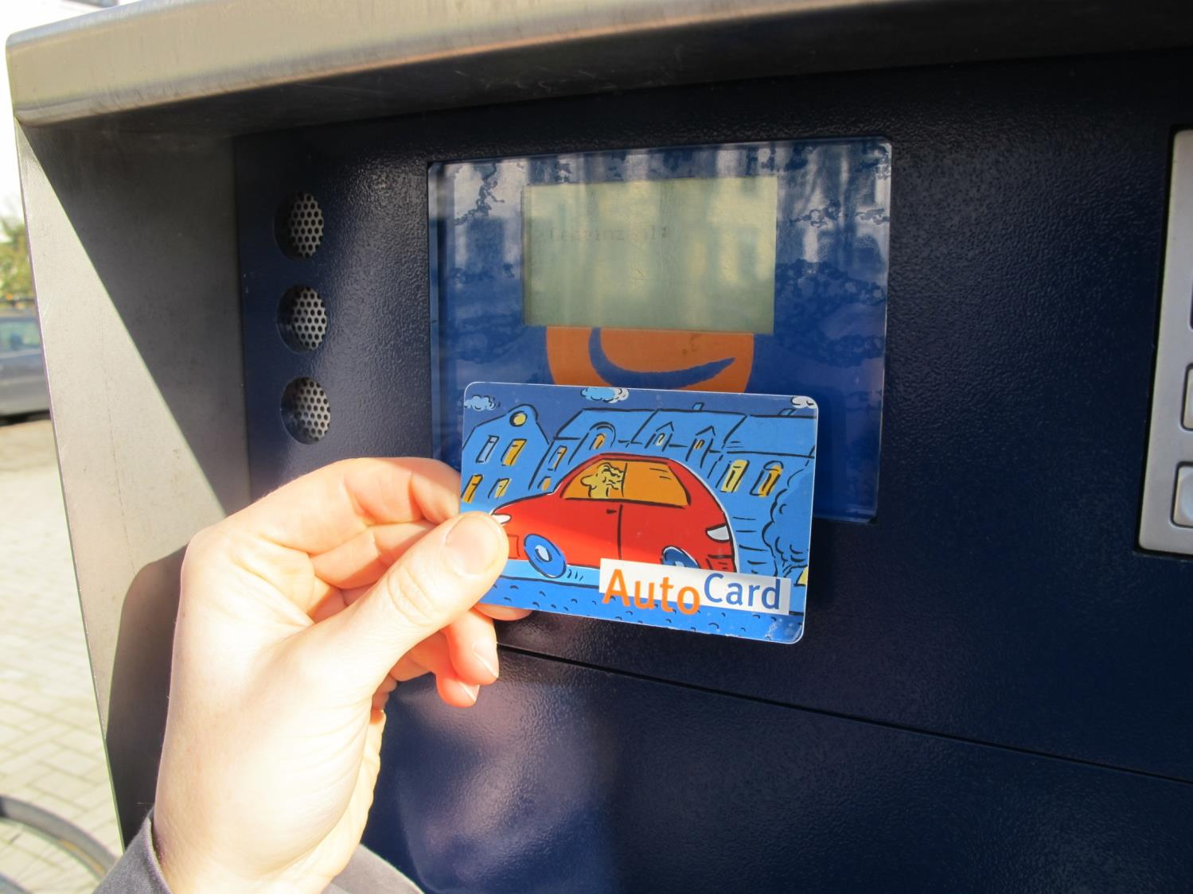
Car-Sharing in Bremen
3 operators, 100+ stations , ~ 330 cars / ~ 14.300 users
12/2017

Slide 18
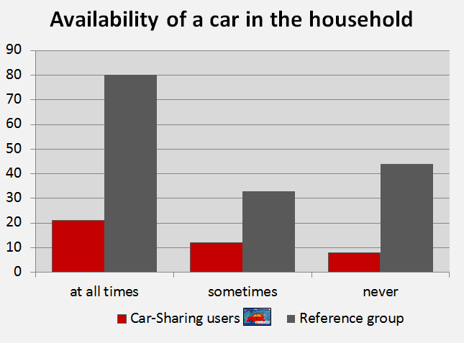
Car-Sharing in Bremen
Impact on car ownership
∼ 80 % have no car
replaces private car ownership
Data: team red, study: Analyse der Auswirkungen des Car-Sharing in Bremen, (2018)

Slide 19
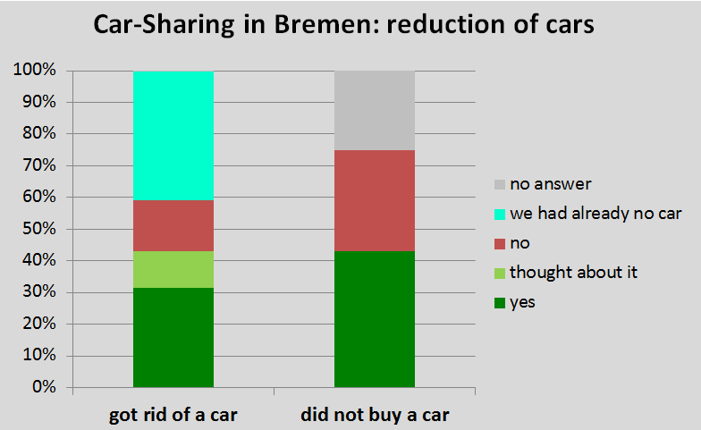
Car-Sharing in Bremen
Impact on car ownership
∼ 30 % got rid of a car
∼ 40 % did not buy a car
Data: team red, study: Analyse der Auswirkungen des Car-Sharing in Bremen, (2018)
Every car sharing car takes 16 cars off the road
1:9
1:7

Slide 20
Car-Sharing in Bremen
About
5.000 cars replaced
by using the service of car sharing in Bremen

Slide 21
Importance of aspects of Car-Sharing and satisfaction level

Slide 22
Importance of aspects of Car-Sharing and satisfaction level

Slide 23
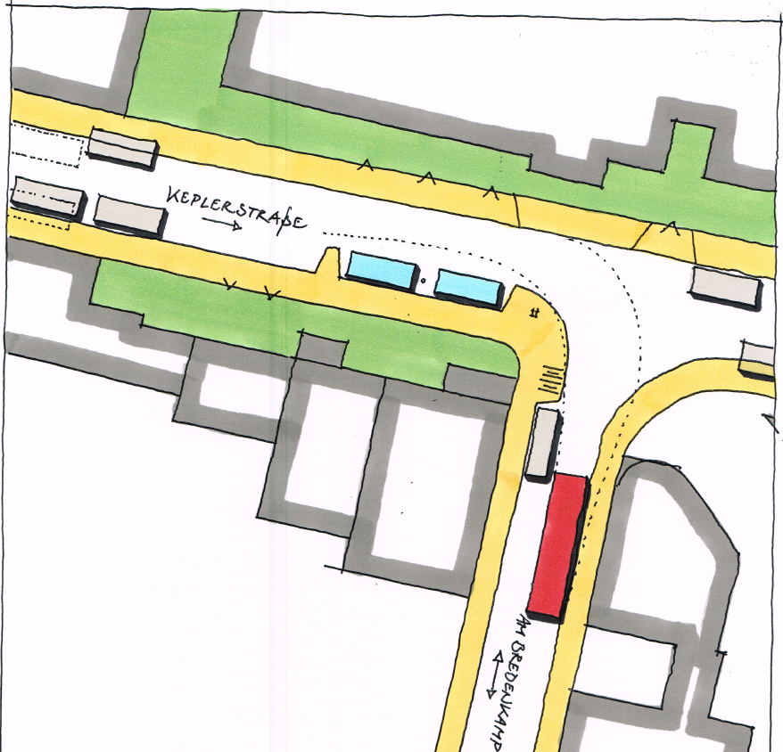
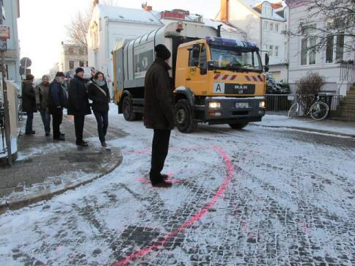
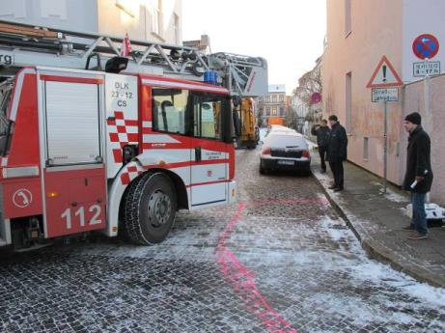

Slide 24
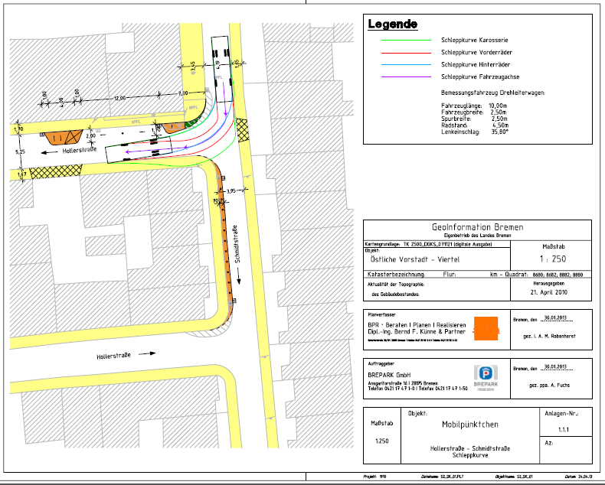
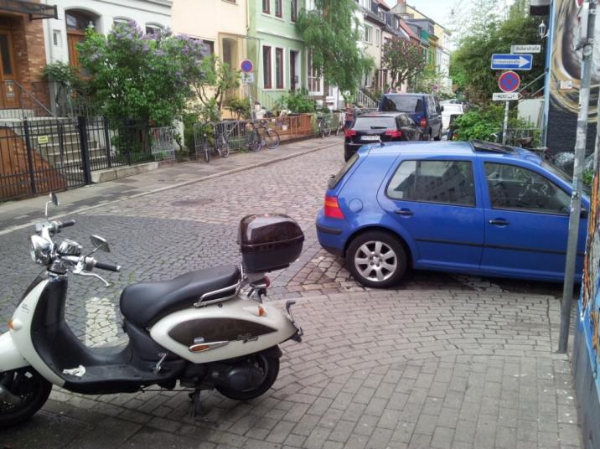
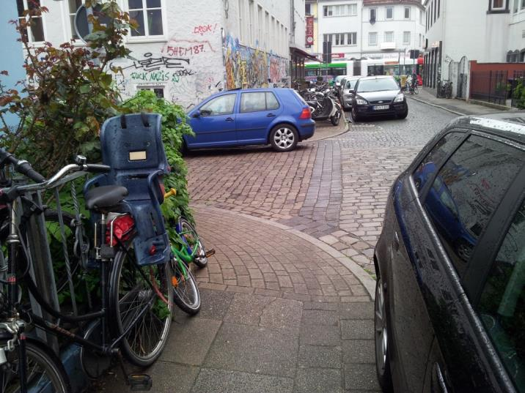
Schmidtstr./Hollerstr.

Slide 26
before

Slide 27
after

Slide 28
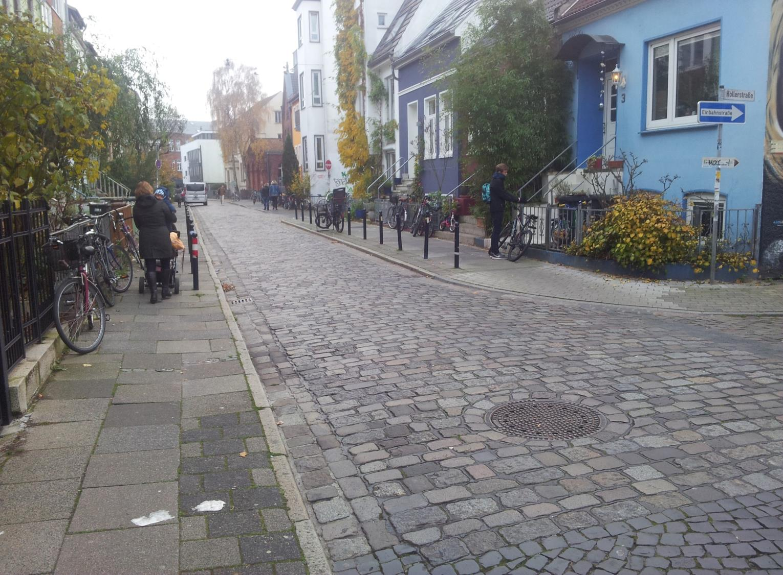

Slide 30
conclusion
Alternative to car ownership is a key to urban regeneration and new developments

Slide 31
Michael Glotz-Richter, City of Bremen michael.glotz-richter@umwelt.bremen.de
Contact
www.sunrise-bremen.de

